Slide 1
Embedded Real-Time Systems
Lecture: Advanced Real Time - 2
Dimitris Metafas, Ph.D.

Slide 2
Interacting Tasks
So far we have assumed tasks do not share resources (semaphores, files, …)
Tasks in practical real-time systems share resources
Sharing resources can cause two problems
  Deadlocks (as in the case of non real-time systems)
  Blocking also called priority inversion
    Happens in non real-time systems, but can cause tasks to miss deadlines in real time systems
Priority Inversion
  Delay to a task’s execution caused by interference from lower priority tasks is known as priority inversion
  UB test can be modified to account for priority inversion by adding blocking time to the worst-case execution time of the task
  Identifying and evaluating the effect of sources of priority inversion is important in schedulability analysis

Slide 3
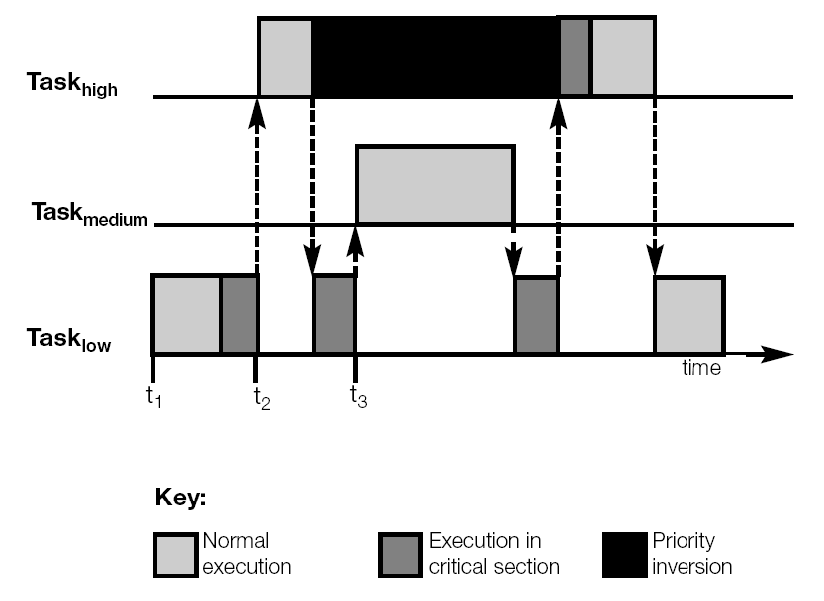
Priority Inversion
Source: Handbook of Real-time Systems

Slide 4
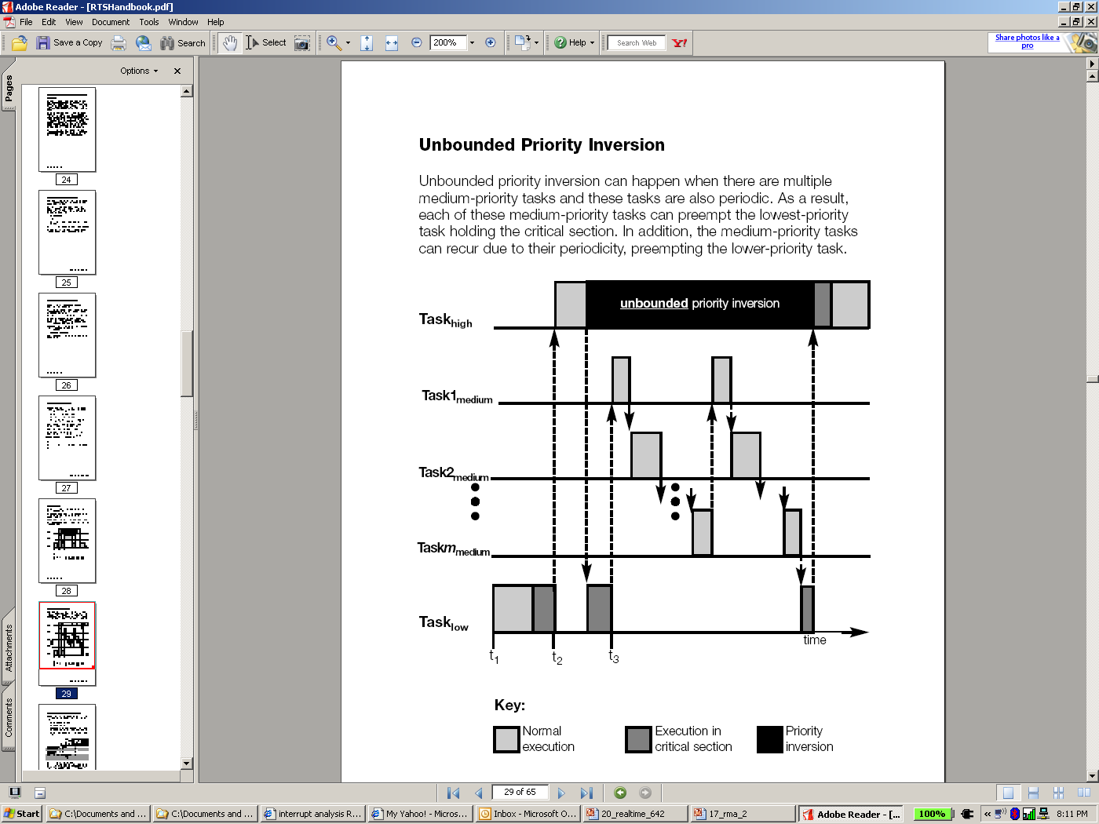
Priority Inversion
Source: Handbook of Real-time Systems

Slide 5
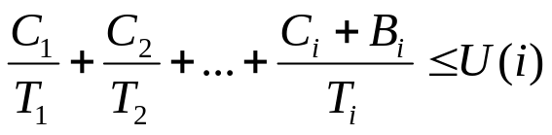
Schedulability Tests with Blocking
A set of n tasks (assuming they are ordered in decreasing priority) are schedulable if
for all i=1,2,3,… n
B_{i} = maximum priority inversion (blocking) encountered by any instance of task T_{i}
B_{n} = 0
Blocking is also included in the RT test – perform the test as before but add the blocking term
i
−
1
a
a
=
B
+
C
+
∑
n
C
n+1
i
i
T
j
j
j
=
1
i
where a
=
B
+
∑
C
0
i
j
j
=
1

Slide 6
Real-time Synchronization Protocols
Basic Priority Inheritance Protocol
Priority Ceiling Protocol
Priority Ceiling Emulation Protocol
  Also called highest locker priority protocol
Each protocol prevents unbounded priority inversion
  You cannot avoid priority inversion, but you can put a time bound on how long it will take
Basic Priority Inheritance Protocol
  A task runs at its own priority until it is blocking a higher priority task, in which case the priority of the task is raised to that of the higher priority task it is blocking

Slide 7
Basic Priority Inheritance Protocol
τ₂: ( … P(S1) … V(S1) …)
τ₄: ( … P(S1) … V(S1) …)
Critical Section
Executing
Attempt to lock S1 (blocked)
Blocked
B
τ₁(H)
S1 Locked
Ready
S1 unlocked
τ₂
B
Ready
τ₃
S1 Locked
S1 unlocked
τ₄(L)
Time

Slide 8
Can Deadlocks Occur in Priority Inheritance?
Task T1 needs mutex L1 and then L2
Task T2 needs mutex L2 and then L1
Task T2 has a higher priority than T1
Suppose T1 runs, locks L1 and is then preempted by T2
Now, T2 runs, locks L2 and needs L1
According to priority inheritance protocol, T1 will be elevated to T2’s priority, and will start to run, but will soon need L2
  L2 has been previously locked by task T2
  T2 cannot release L2 because it is blocked, waiting for L1
Both tasks are deadlocked!
How do we work around this?

Slide 9
Priority Ceiling Protocol
Each resource is assigned a priority ceiling which is the priority of the highest task that uses the resource
Current priority ceiling – highest priority ceiling of the resources currently acquired by the tasks
Rules of priority ceiling protocol
  Scheduling Rule: Each job runs at its assigned priority outside a critical section
  Allocation Rule: Whenever a job J requests a critical section R (resource), one of the following two conditions happen
    R is held by another job; request fails and J blocks
    R if free
      If J’s priority is higher than the current priority ceiling, R is allocated to J
      If J’s priority is not higher than the current priority ceiling, R is allocated to J only if J is the job holding the resources whose priority ceiling is equal to the current priority ceiling
  Priority-Inheritance Rule: When J blocks in allocation rule 1 or 2(ii) the job blocking J inherits J’s priority

Slide 10
PCP example 1
τ₁: ( … P(S0) … V(S0) …)
τ₂: ( … P(S1) … V(S1) …)
τ₄: ( … P(S1) … V(S1) …)
Critical Section
Executing
Blocked
B
Attempt to lock S1 (blocked)
τ₁(H)
S1 Locked
Ready
τ₂
C
B
Ready
τ₃
S1 Locked
S1 unlocked
τ₄(L)
Time

Slide 11
PCP example 2
τ₁: ( … P(S0) …………………… V(S0) …)
τ₂: ( … P(S2) … V(S2) …P(S1)…V(S1)…)
τ₄: ( … P(S1) … P(S2) …V(S2)…V(S1) …)
Critical Section
Executing
Blocked
B
Attempt to lock S2 (blocked)
S1 Locked
τ₁(H)
S2 Locked
S1 unlocked
Ready
S2 unlocked
τ₂
Ready
τ₃
S1 Locked
S2 Locked
S2 unlocked
S1 unlocked
τ₄(L)
Time

Slide 12
PCP
Advantage: Prevents deadlock
  If processes share resources, the process that grabs the first resource is allowed to grab all other resources while all other processes get blocked due to allocation rule 1 or 2(ii)
  Example
    Task T1 needs mutex L1 and then L2
    Task T2 needs mutex L2 and then L1
    Task T2 has a higher priority than T1
    Priority ceiling of L1 is and L2 is
    Suppose T1 runs, locks L1 and is then preempted by T2
    Now, T2 runs, tries to lock L2…
Disadvantage:
  Need to do task analysis to determine priority ceiling of resources
  Can cause unnecessary blocking of tasks (in example 2, task 2 need not block for S2)

Slide 13
Priority Ceiling Emulation Protocol
Also called Highest Locker Priority Protocol
Task executes at a priority higher than or equal to the priority ceiling of a resource as soon as it gets access to the resource
τ₂: ( … P(S1) … V(S1) …)
τ₄: ( … P(S1) … V(S1) …)
Critical Section
Executing
Blocked
B
τ₁(H)
Ready
τ₂
B
Ready
τ₃
S1 Locked
S1 unlocked
τ₄(L)
Time

Slide 14
Case: Mars Rover Priority Inversion Problem
Mars Rover experienced total system resets
Operating system used: WindRiver’s VxWorks
  Preemptive priority scheduling of threads
Rover’s priority-based architecture
  High-priority thread managed the information bus
  Medium-priority thread ran a communications task
  Low-priority data-gathering thread used bus to publish data
  Bus access governed by mutex
What happened?
  High-pri task blocked, waiting for low-pri task to release mutex
  Interrupt would occur, causing med-pri task to be scheduled
  Watchdog timer would notice that high-pri task did not run for a while, and cause a total system restart

